Slide 1


Dhava Gautama
28 July 2024

Slide 2

Outline
Executive Summary
Introduction
Methodology
Results
Conclusion
Appendix

Slide 3
Executive Summary
Summary of methodologies
Data Collection through API and Web Scrapping
Data Wrangling
Explanatory Data Analysis with SQL
Explanatory Data Analysis with Data Visualization
Interactive Visual Analytics with Folium
Machine Learning Prediction
Summary of all results
Explanatory Data Analysis Result
Interactive analytics screenshot
Predictive Analytics result from Machine Learning Lab

Slide 4
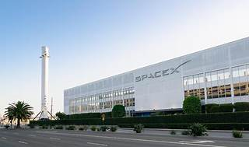
Introduction
SpaceX is a company that has revolutionized the space industry by offering Falcon 9 rocket launches for as low as 62 million dollars, while other providers charge upward of 165 million dollars per launch. The company has been able to achieve this by reusing the first stage of the rocket, which has helped reduce the cost of launches. The first stage of the rocket is re-landed and then used on the next mission, which further reduces the cost of launches. As a data scientist working for a startup that is competing with SpaceX, your goal is to create a machine learning pipeline that can predict the landing outcome of the first stage of the rocket in the future. This project is crucial in identifying the right price to bid against SpaceX for a rocket launch.
Key problem included in this project are :
Identifying factors that influence the landing outcome,
Find relationship between variable and it effect on landing outcome,
Find the best condition that needed to increase success landing rate.

Slide 5

Section 1

Slide 6
Methodology
Executive Summary
Data collection methodology:
Data was collected from SpaceX API and web scrapping
Perform data wrangling
Filtering the data
Dealing with missing values
Perform exploratory data analysis (EDA) using visualization and SQL
Perform interactive visual analytics using Folium and Plotly Dash
Perform predictive analysis using classification models
Build, tune, evaluate classification models

Slide 7
Data Collection
Data collection process combined two key methods: API requests from the SpaceX REST API and web scraping from SpaceX's Wikipedia page. Utilizing both approaches allowed us to gather comprehensive information about SpaceX launches, facilitating a detailed analysis.
This dual-method approach ensured we captured all relevant details for our analysis of SpaceX launches.

Slide 8
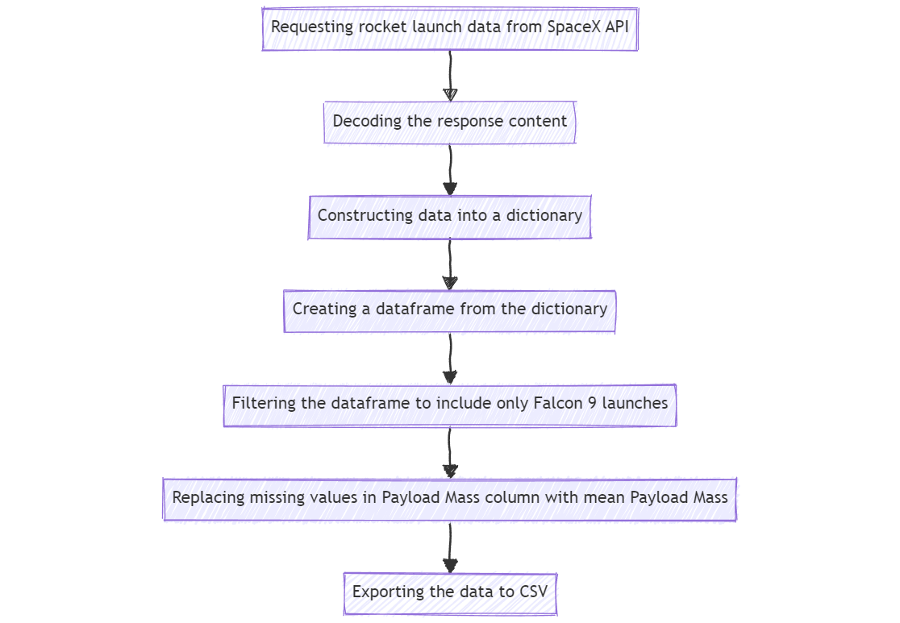
Data Collection – SpaceX API
I collect the data from the SPACEX API then filter the data to include only Falcon 9 launches, then the missing values in Payload Mass column is replaced with the respective mean value of the column
Data Collection – SpaceX API Github

Slide 9
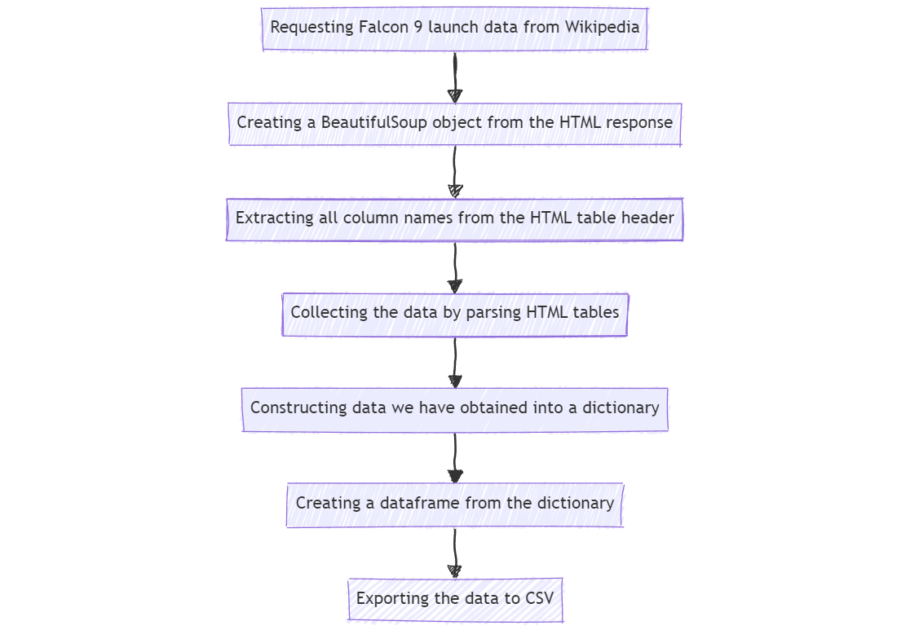
Data Collection - Scraping
The data scrapped from the Wikipedia page then extracted by using BeautifulSoup, then the extracted data is constructed to be a dataframe.
Data Collection – Scraping Github

Slide 10
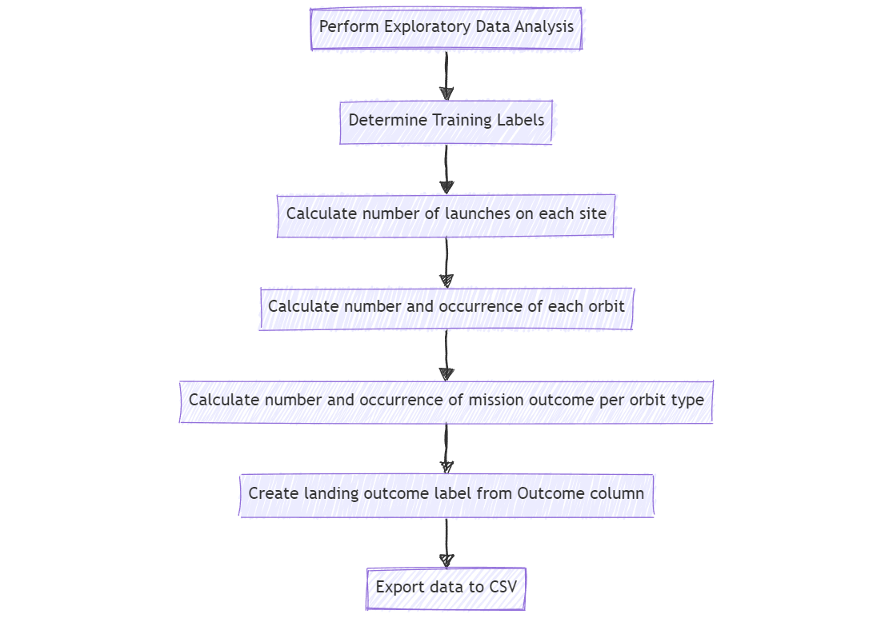
Data Wrangling
Data Exploration: The data wrangling process began with performing exploratory data analysis to gain insights into the data structure and content.
Label Determination: Next, training labels were determined to prepare the data for modeling.
Feature Engineering: The data was then processed to extract relevant features
Data Transformation: A new feature, landing outcome label, was created from the existing Outcome column.
Data Export: Finally, the processed data was exported to CSV for further analysis or modeling.
Data Wrangling Github

Slide 11
EDA with Data Visualization
Chart Plotted
Relationship between Flight Number and Launch Site
Relationship between Payload and Launch Site
Relationship between success rate of each orbit type
Relationship between FlightNumber and Orbit type
Relationship between Payload and Orbit type
Launch success yearly trend
EDA with Data Visualization Github

Slide 12
EDA with SQL
Performed SQL queries:
Displaying the names of the unique launch sites in the space mission
Displaying 5 records where launch sites begin with the string ‘CCA'
Displaying the total payload mass carried by boosters launched by NASA (CRS)
Displaying average payload mass carried by booster version F9 v1.1
Listing the date when the first successful landing outcome in ground pad was achieved
Listing the names of the boosters which have success in drone ship and have payload mass greater than 4000 but less than 6000
Listing the total number of successful and failure mission outcomes
Listing the names of the booster versions which have carried the maximum payload mass
Listing the failed landing outcomes in drone ship, their booster versions and launch site names for the months in year 2015
Ranking the count of landing outcomes (such as Failure (drone ship) or Success (ground pad)) between the date 2010-06-04 and 2017-03-20 in descending order
EDA with SQL Github

Slide 13
Build an Interactive Map with Folium
Visualizing Launch Sites and Outcomes
Launch Site Markers:
A marker with a circle, popup label, and text label was added to denote the NASA Johnson Space Center, utilizing its precise latitude and longitude coordinates as the starting location.
Markers with circles, popup labels, and text labels were added to identify all launch sites, leveraging their latitude and longitude coordinates to illustrate their geographical locations and proximity to the Equator and coastlines.
Launch Outcome Indicators:
Colored markers were used to distinguish between successful (green) and failed (red) launches, employing a marker cluster to highlight launch sites with relatively high success rates.
Proximity Analysis:
Colored lines were added to visualize the distances between a launch site (e.g., KSC LC-39A) and its surrounding features, including railways, highways, coastlines, and the closest city.
Build an Interactive Map with Folium Github

Slide 14
Build a Dashboard with Plotly Dash
Launch Site Selection:
A dropdown list was integrated to facilitate the selection of a specific launch site, enabling users to focus on individual site performance.
Launch Outcome Analysis:
A pie chart was added to provide a comprehensive view of launch outcomes, displaying the total number of successful launches across all sites and, when a specific site is selected, the proportion of successful versus failed launches for that site.
Payload Mass Filtering:
A slider was incorporated to allow users to select a specific payload mass range, enabling the exploration of launch outcomes within defined payload parameters.
Payload Mass vs. Success Rate Correlation:
A scatter chart was created to illustrate the relationship between payload mass and launch success rate for different booster versions, providing insights into the impact of payload mass on launch outcomes.
Build a Dashboard with Plotly Dash Github

Slide 15
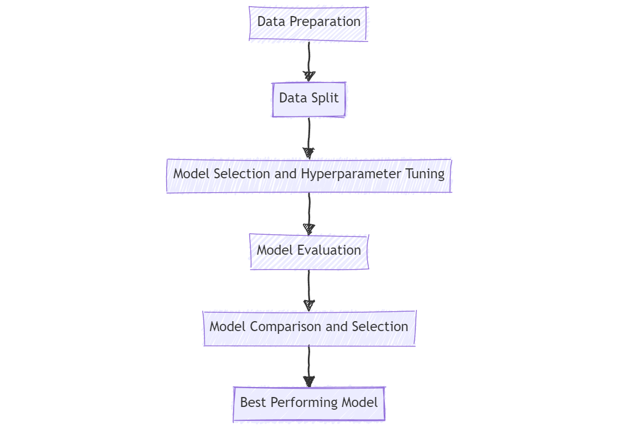
Predictive Analysis (Classification)
Step 1: Data Preparation
Create a NumPy array from the "Class" column in the data
Standardize the data using StandardScaler (fit and transform)
Step 2: Data Split
Split the data into training and testing sets using train_test_split function
Step 3: Model Selection and Hyperparameter Tuning
Step 4: Model EvaluaCreate a GridSearchCV object with cv = 10 to find the best parameters
Apply GridSearchCV to LogReg, SVM, Decision Tree, and KNN models
tion
Calculate the accuracy on the test data using the .score() method for all models
Examine the confusion matrix for all models
Step 5: Model Comparison and Selection
Find the method that performs best by examining the accuracy, best scores, and F1_score metrics
Predictive Analysis (Classification) Github

Slide 16
Results
Exploratory data analysis results
Interactive analytics demo in screenshots
Predictive analysis results

Slide 17

Section 2

Slide 18
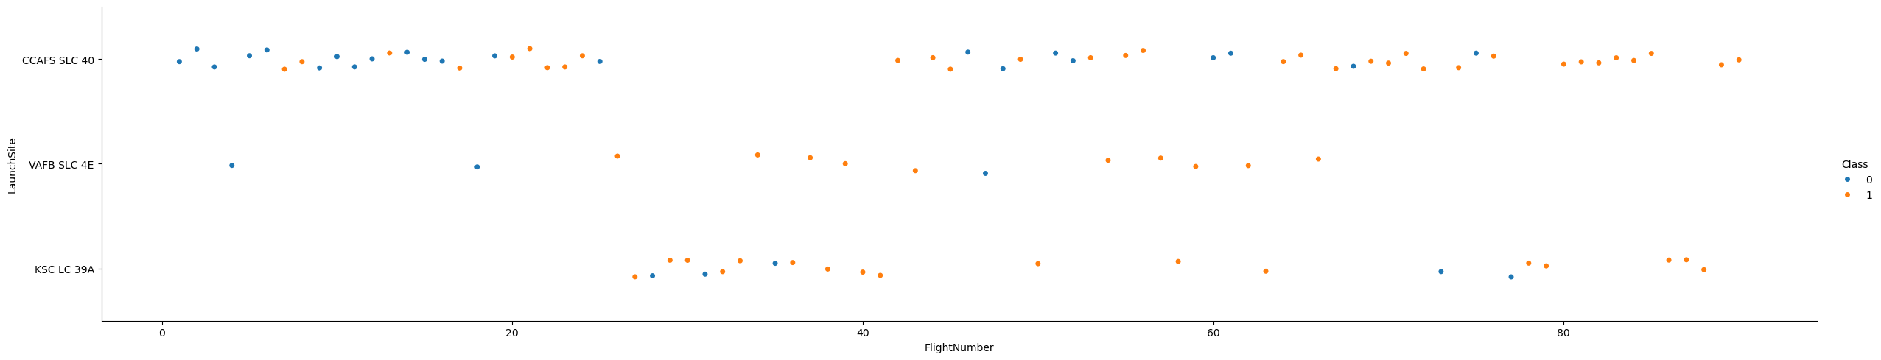
Flight Number vs. Launch Site
Trends:
The earliest flights all failed, while the latest flights have all succeeded, suggesting an overall improvement in success rates over time.
It can be inferred that each new launch has a higher rate of success.

Slide 19
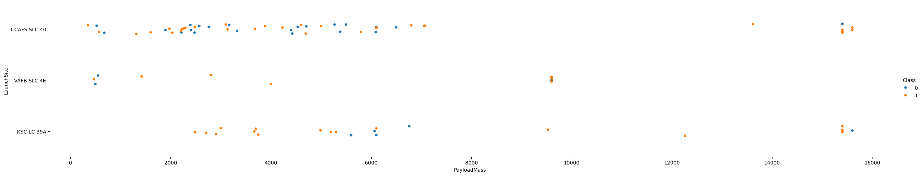
Payload vs. Launch Site
All VAFB SLC 4E payload mass are below 10000 kg
For payload under 5500 kg the launch site KSC LC 39A has 100 % success rate

Slide 20
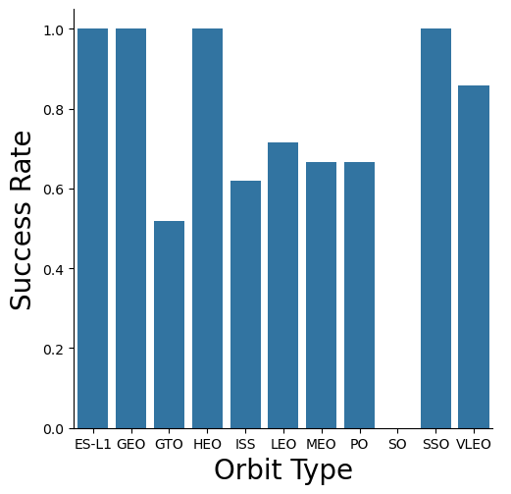
Success Rate vs. Orbit Type
Orbit with 100% Success Rate are ES-L1, GEO, HEO, SSO
Orbit with Success Rate higher than 0% less than 100% are GTO, ISS, LEO, MEO, PO, VLEO
Orbit with 0% Success Rate is SO

Slide 21
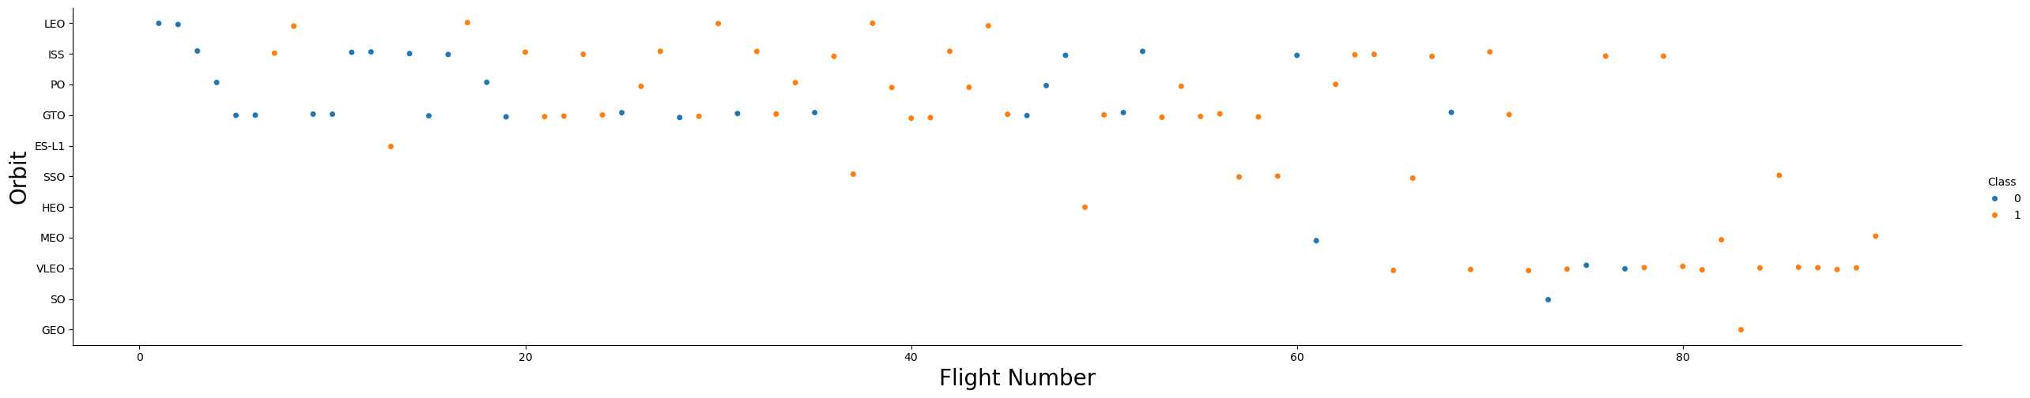
Flight Number vs. Orbit Type
LEO orbit the Success appears related to the number of flights; on the other hand, there seems to be no relationship between flight number when in GTO orbit.

Slide 22
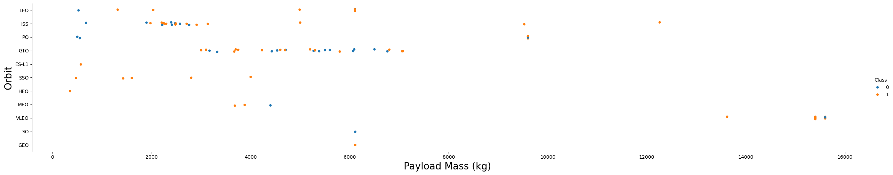
Payload vs. Orbit Type
With heavy payloads the successful landing or positive landing rate are more for Polar,LEO and ISS.
However for GTO we cannot distinguish this well as both positive landing rate and negative landing(unsuccessful mission) are both there here.

Slide 23
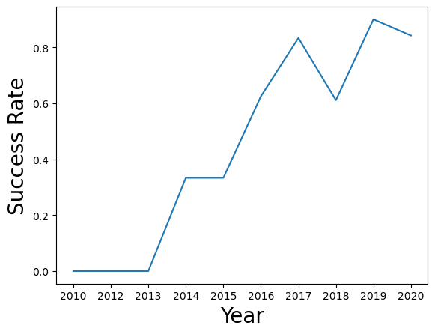
Launch Success Yearly Trend
The success rate since 2013 kept increasing till 2017 (stable in 2014) and after 2015 it started increasing.

Slide 24
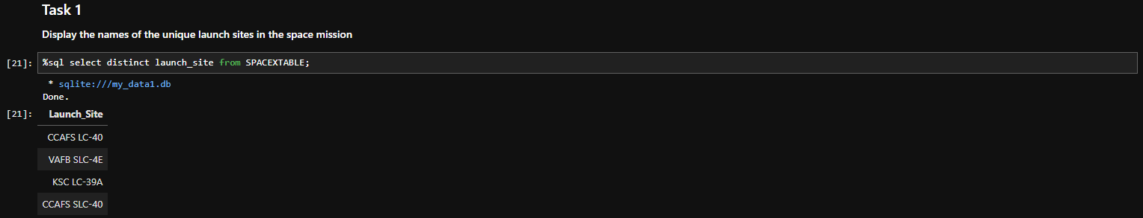
All Launch Site Names
Find the names of the unique launch sites

Slide 25
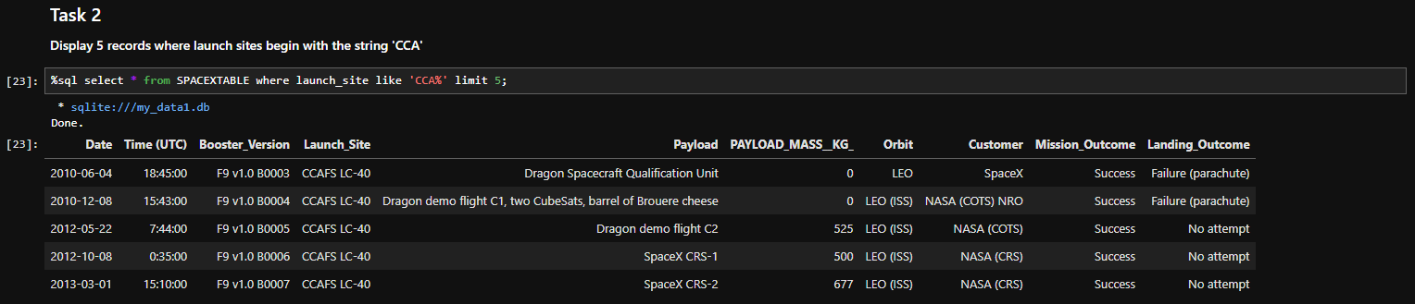
Launch Site Names Begin with 'CCA'
Find 5 records where launch sites begin with `CCA`

Slide 26
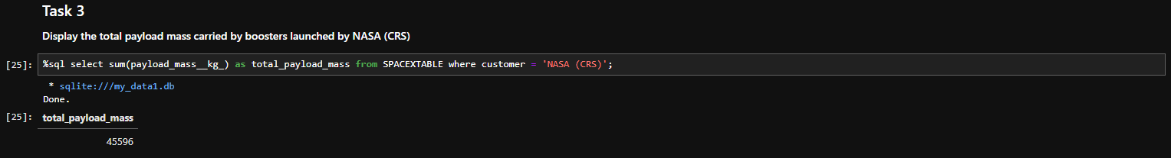
Total Payload Mass
Calculate the total payload carried by boosters from NASA

Slide 27
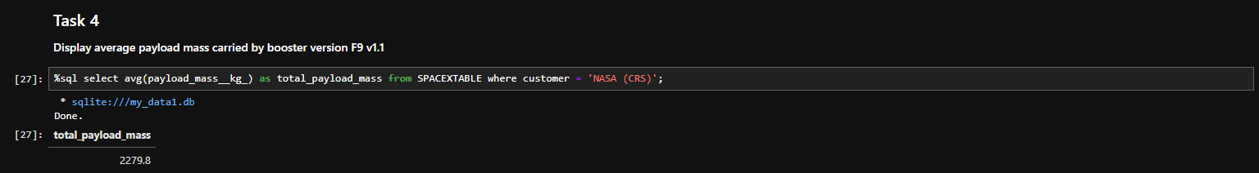
Average Payload Mass by F9 v1.1
Calculate the average payload mass carried by booster version F9 v1.1

Slide 28
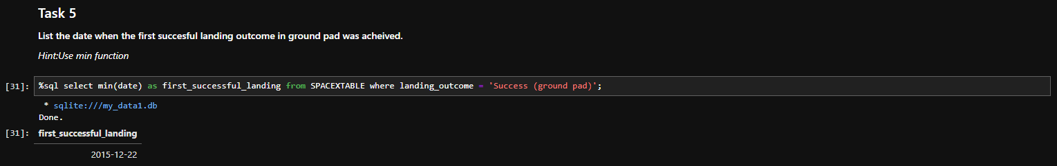
First Successful Ground Landing Date
Find the dates of the first successful landing outcome on ground pad

Slide 29
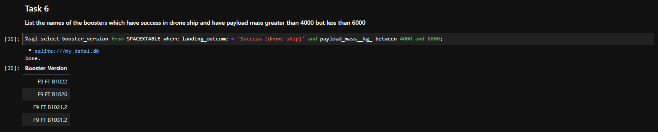
Successful Drone Ship Landing with Payload between 4000 and 6000
List the names of boosters which have successfully landed on drone ship and had payload mass greater than 4000 but less than 6000

Slide 30
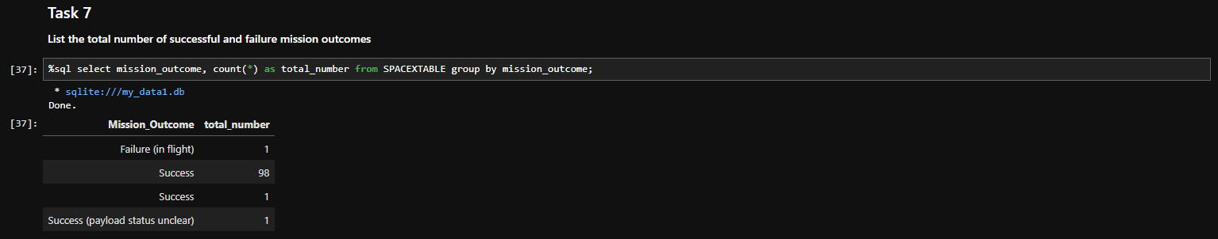
Total Number of Successful and Failure Mission Outcomes
Calculate the total number of successful and failure mission outcomes

Slide 31
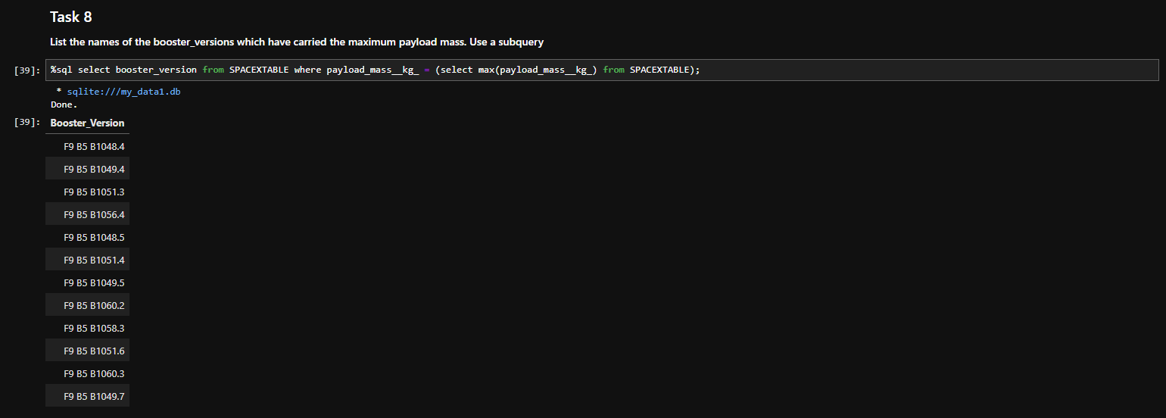
Boosters Carried Maximum Payload
List the names of the booster which have carried the maximum payload mass

Slide 32
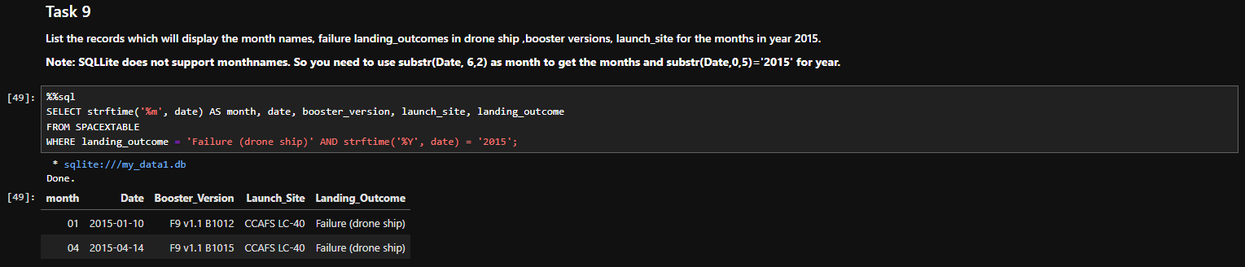
2015 Launch Records
List the failed landing_outcomes in drone ship, their booster versions, and launch site names for in year 2015

Slide 33
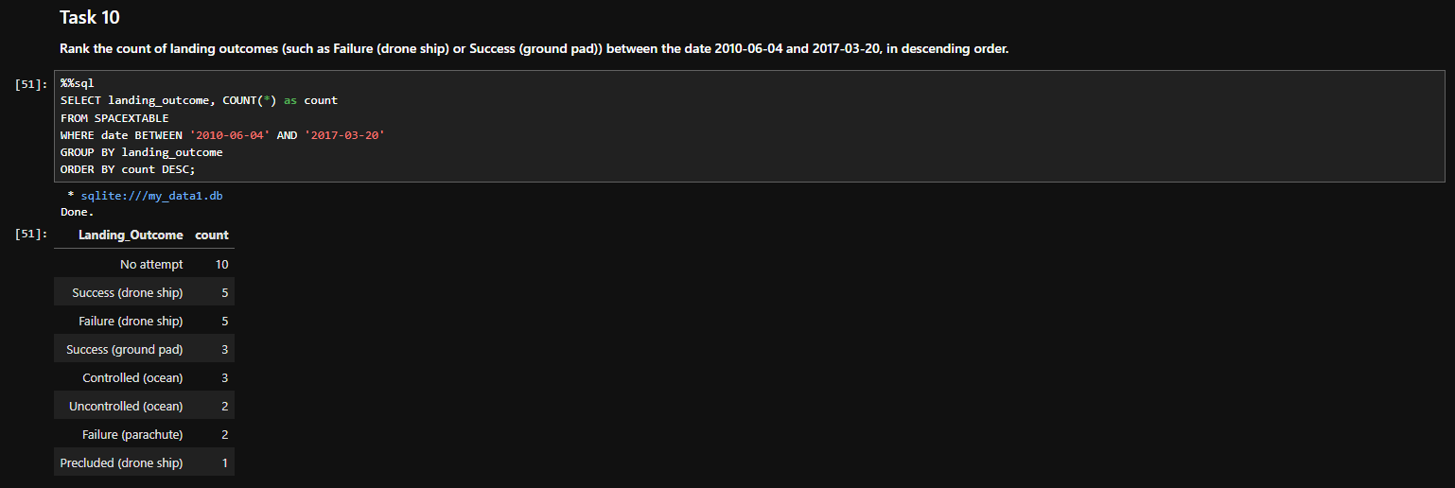
Rank Landing Outcomes Between 2010-06-04 and 2017-03-20
Rank the count of landing outcomes (such as Failure (drone ship) or Success (ground pad)) between the date 2010-06-04 and 2017-03-20, in descending order

Slide 34

Section 3

Slide 35
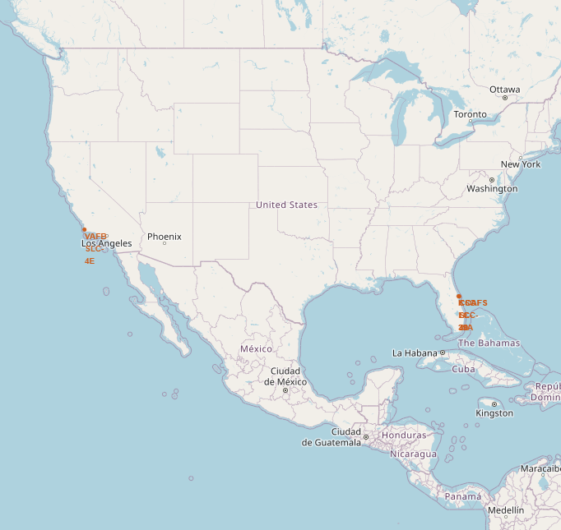
All launch sites’ location markers on a global map
Most launch sites are strategically located near the Equator. This proximity provides a significant advantage, as the initial velocity of the launch site is inherited by the spacecraft due to inertia, helping it achieve the necessary speed to stay in orbit. Additionally, all launch sites are situated close to the coast, allowing rockets to be launched over the ocean, thereby minimizing the risk of debris falling or exploding near populated areas.

Slide 36
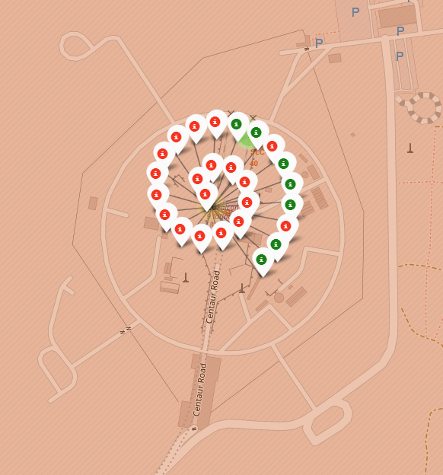
Colour-labeled launch records on the map
By referencing the color-coded markers, we can quickly identify the launch sites with high success rates. The green markers indicate successful launches, while the red markers denote failed launches, providing a visual representation of each site's performance.

Slide 37
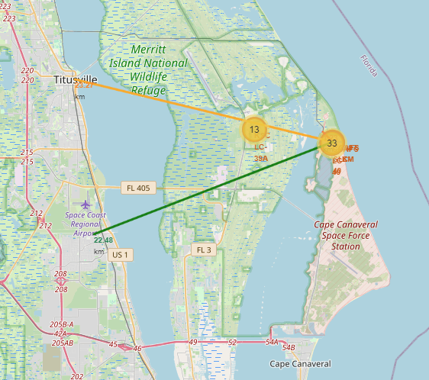
Distance from the launch site CCAFS LC-40 to its proximities
From the visual analysis of the launch site CCAFS LC-40 we can clearly see that it is:
- relative close to railway (1.23 km)
- relative close to highway (22.48 km)
- relative close to coastline (0.87 km)
- relative close to city Titusville (23.27 km).

Slide 38

Section 4

Slide 39
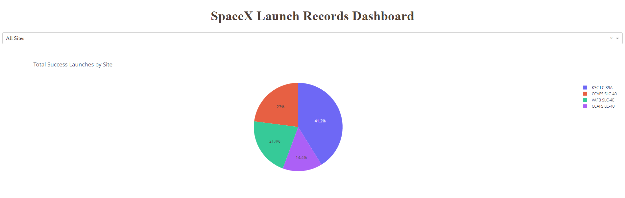
Launch success count for all sites
KSC LC-39A have the highest total success launches followed by CCAFS SLC-40 then VAFB SLC-4E, and CCAFS LC-40

Slide 40
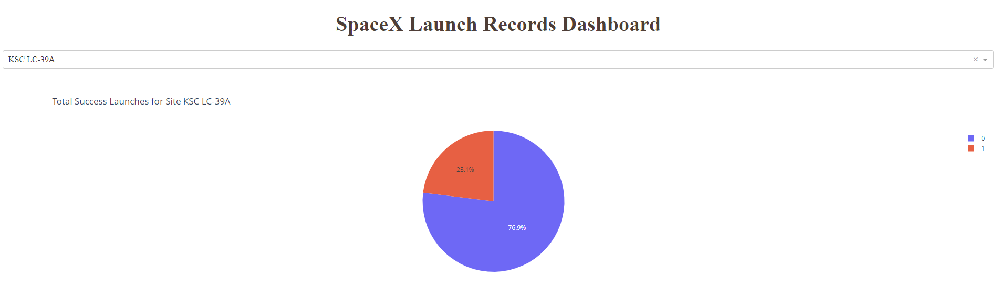
Launch site with highest launch success ratio
KSC LC-39A has the highest launch success rate (76.9%)

Slide 41
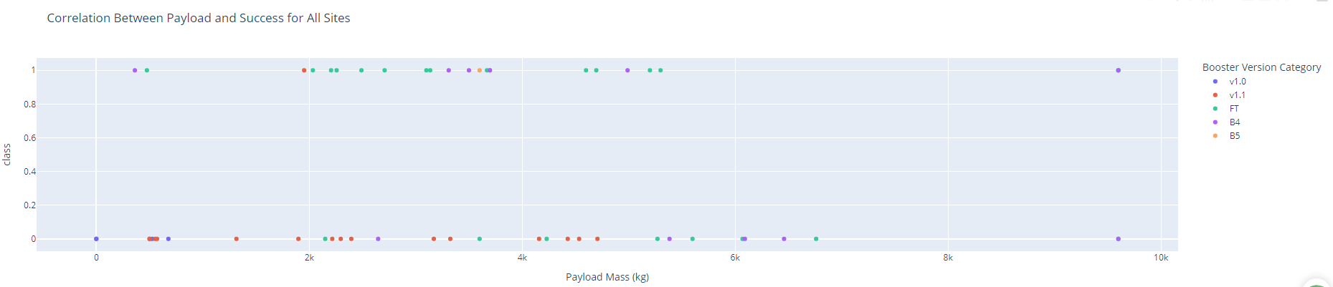
Payload vs. Launch Outcome scatter plot for all sites
The charts show that payloads between 2000 and 5500 kg have the highest success rate

Slide 42

Section 5

Slide 43
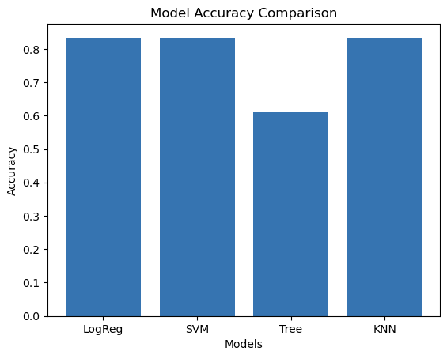
Classification Accuracy
LogReg, SVM, and KNN have the same accuracy
The Tree accuracy is lower than the others
The identical scores on the Same Test Set may be attributed to the limited test sample size of only 18 samples, which could be insufficient to capture significant differences.

Slide 44
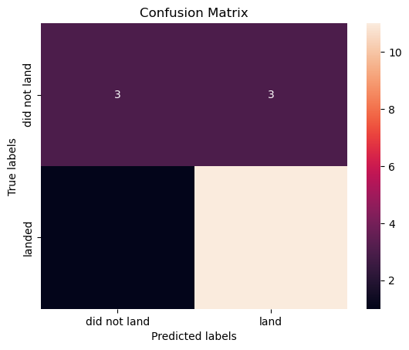
Confusion Matrix
Upon examining the confusion matrix, we observe that logistic regression is capable of distinguishing between the different classes. However, a closer inspection reveals that the primary challenge lies in the occurrence of false positives, which is a key area for improvement.

Slide 45
Conclusions
In this project, we aimed to develop a predictive model that determines the likelihood of a Falcon 9 launch's first stage landing, which is a crucial factor in determining the cost of a launch. Our key findings and approach can be summarized as follows:
• We explored the relationships between various features of a Falcon 9 launch, such as payload mass and orbit type, and their impact on the mission outcome.
• We employed multiple machine learning algorithms on historical Falcon 9 launch data to identify patterns and develop predictive models.
• Our models can be used to accurately forecast the outcome of future launches, providing valuable insights for launch cost estimation.

Slide 46


